Slide 1

Optimized Computer Vision System for Traffic Sign Recognition and Detection in Autonomous Vehicles; Using a Convolutional Neural Network

Slide 2
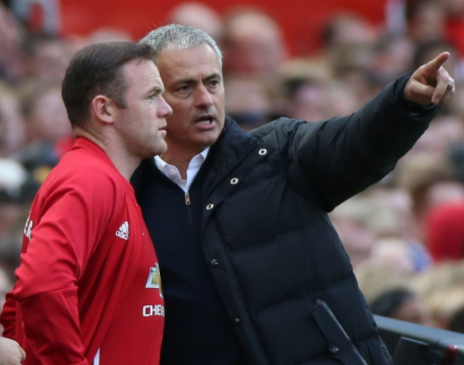


USUAL VISION SYSTEM WORK FLOW
1
3
2
DETECT
INSTRUCT
CLASSIFY

Slide 3
PRESENTATION OVERVIEW
DETECTION
Connected Component Analysis
Shape Analysis
Critical Area Analysis
Circle Detection
CLASSIFICATION
BNN vs ANN
ANN
TRAINING THE ANN
CNN
CNN LAYERS OF OPERATION
OPTIMIZATION
Parallel Computing
Heterogeneous
Computing
Legacy Coding
Vectorization
Result

Slide 4
DETECTION (Case Study: Traffic Sign Recognition and Detection in Autonomous Vehicles)

Slide 5
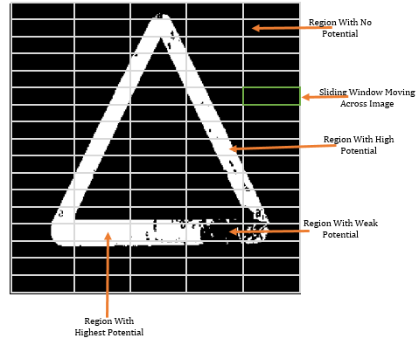
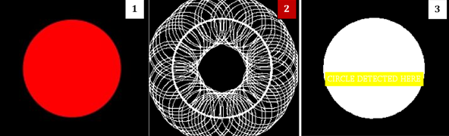
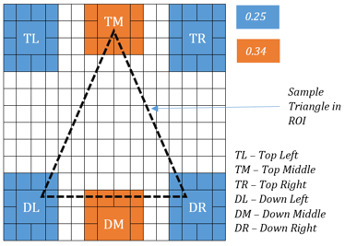
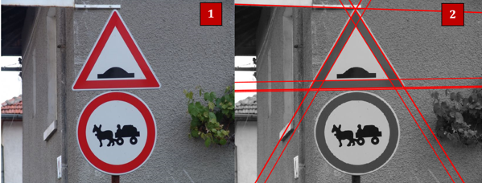
DETECTION
CIRCLE DETECTION USING CIRCULAR HOUGH TRANSFORM
CONNECTED COMPONENT ANALYSIS
CRITICAL AREA ANALYSIS
LINE DETECTION USING HOUGH TRANSFORM TRANSFR

Slide 6
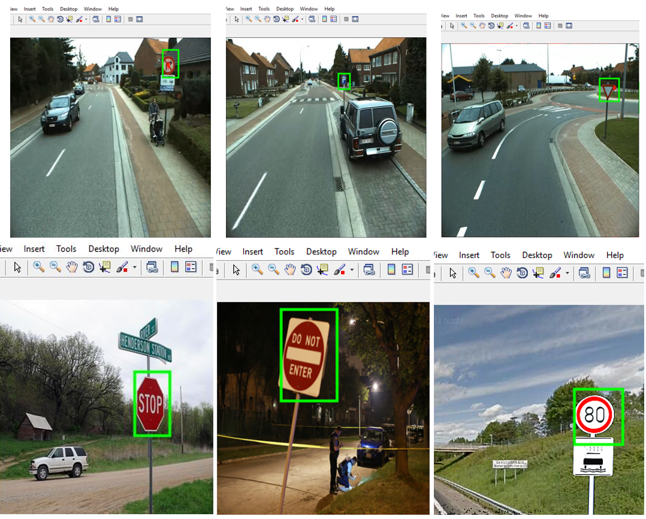
DETECTION RESULT

Slide 7
CLASSIFICATION (Case Study: Traffic Sign Recognition and Detection in Autonomous Vehicles)

Slide 8
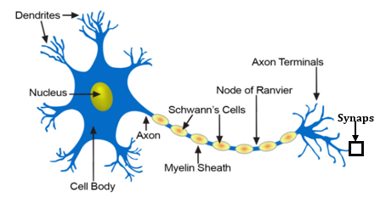
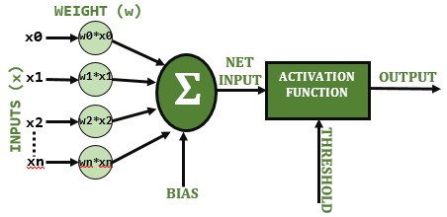
BNN vs ANN
vs

Slide 9
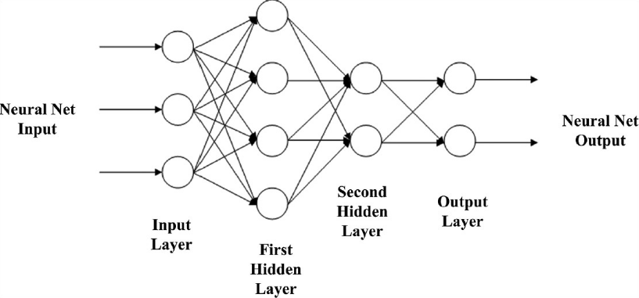
ANN

Slide 10

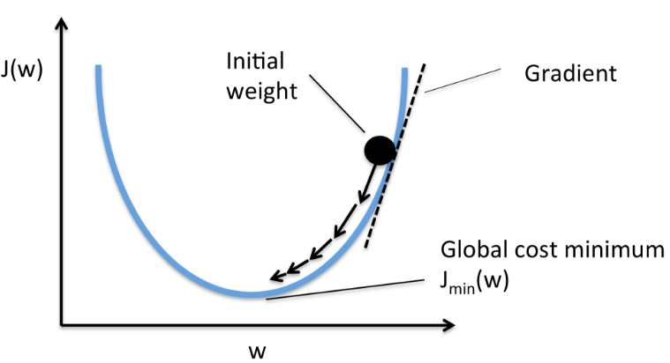

TRAINING THE ANN
Using Gradient Descent
Training
TRAINING DATA
[----------------]
ARTIFICIAL NEURAL NETWORK (ANN)
ANN OUTPUT
CLOCK
(Has Network Converged?)
Error Signal
TEACHER
Clock Signal
+
$$\sum{.}$$
-
Target Output
Least Mean Squared Error Computation

Slide 11
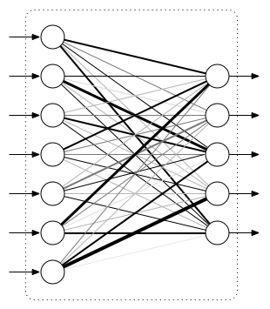
CNN
CONVOLUTIONAL NEURAL NETWORK
FULLY CONNECTED LAYER = MULTILAYER PERCEPTRON
SERIES OF CONVOLUTION, RECTIFICATION AND POOLING
INPUT IMAGE
OUTPUT RESULTS
FEATURE EXTRACTOR
CLASSIFIER

Slide 12
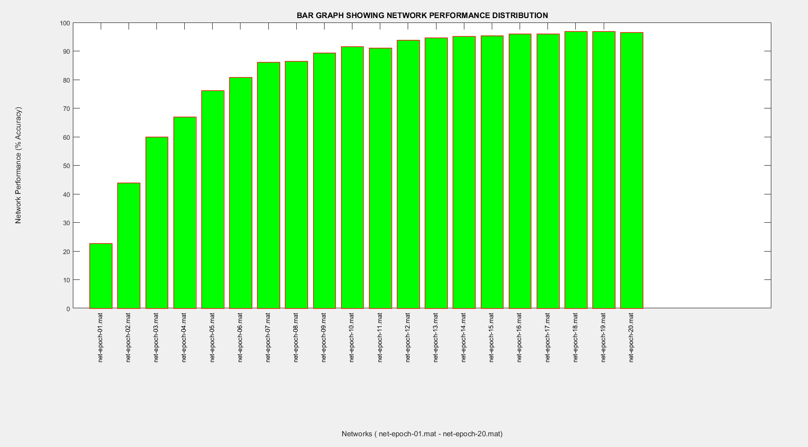
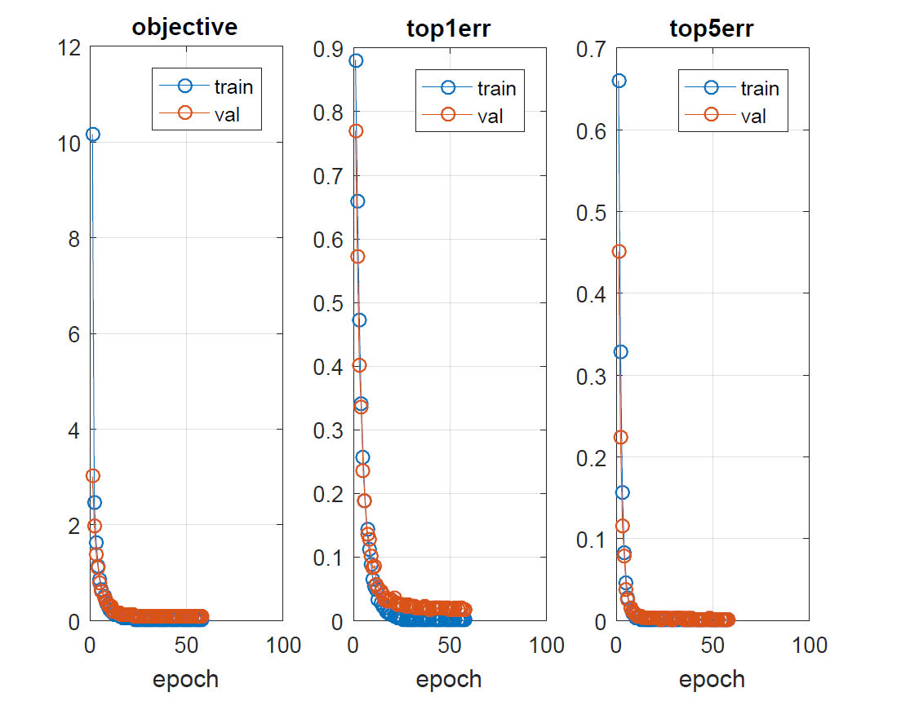
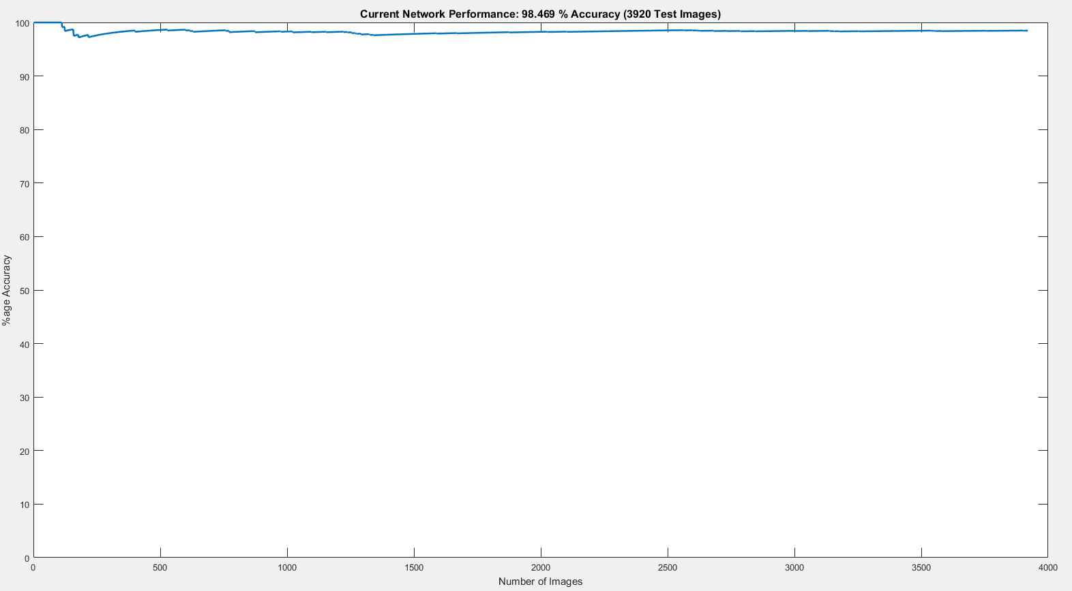
CLASSIFICATION RESULT (1)

Slide 13
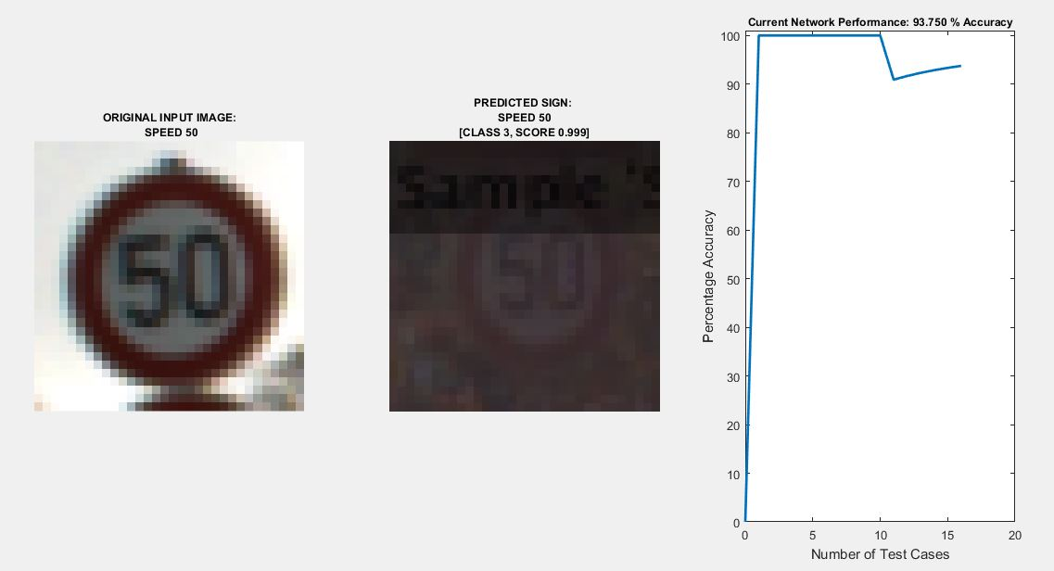
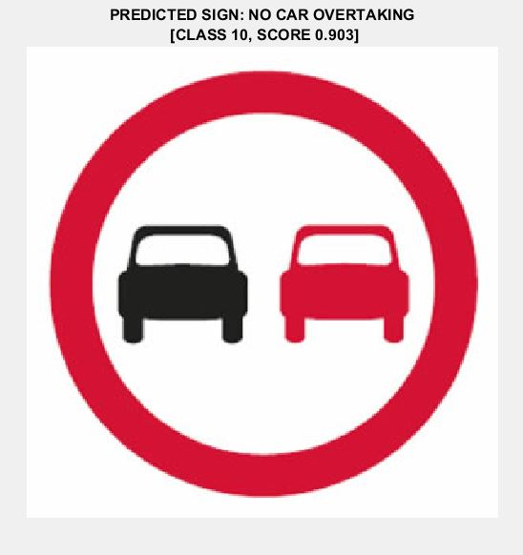
CLASSIFICATION RESULT (2)

Slide 14
Optimization (Case Study: Traffic Sign Recognition and Detection in Autonomous Vehicles)

Slide 15
DETECTION
Search
Connected Component Analysis
Sliding Window Detection
Line Detection (Hough Transform)
Circular Hough Transform
Shape Analysis
COMPUTATIONALLY EXPENSIVE!!

Slide 16
CLASSIFICATION
Neural Networks Processes
Machine Learning Algorithms
COMPUTATIONALLY EXPENSIVE!!

Slide 17
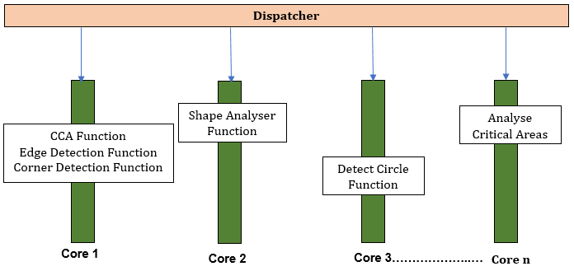
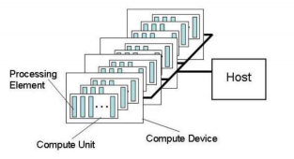
Vectorization Parallel Dispatch
Legacy Coding Heterogeneous Computing
for x=1:xDimension
for y=1:yDimension
img(x,y) = value;
end
end
img(:) = value
C/C++, Fortran, Assembly

Slide 18
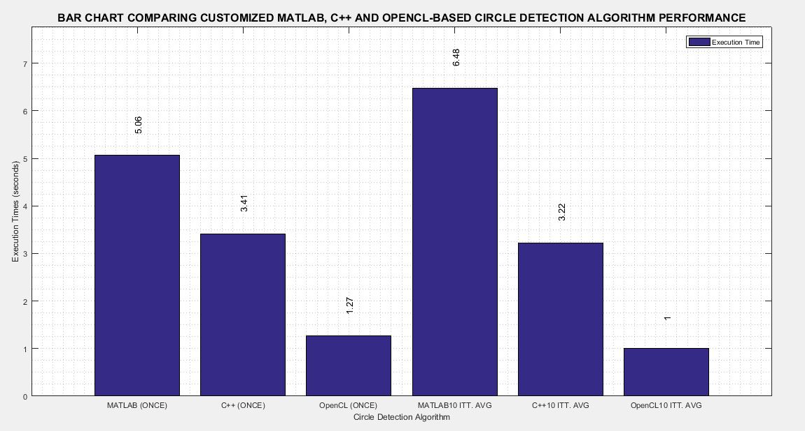
INTEGRATED SYSTEM RESULT
COMPUTER DETAILS
RAM: 16GB
OS: 64bit Windows OS
Processor: Intel ® Core TM i5
Processor Speed: 2.70 GHz
Image Size: 500x500
S/N | Detection Function | Un-Optimized MATLAB (s/frame) | Optimized MATLAB (s/frame) | Improvement (MATLAB un-optimized vs optimized) | C++ (s/frame) | Improvement (MATLAB un-optimized vs C/C++)
1 | analyseCriticalAreas.m | 0.080 | 0.0935 | Optimized version, 1.16 times slower | 0.107 | C/C++ version, 1.33 times slower
2 | CCA.m | 0.349 | 0.0724 | Optimized version, 4.8 times faster | 0.000687 | C/C++ version, 508 times faster
3 | detectCircle.m | 0.301 | 0.114 | Optimized version, 2.64 times faster | 0.167 | C/C++ version, 1.8 times faster
5 | detectEdge.m | 0.269 | 0.0203 | Optimized version, 13.25 times faster | 0.0157 | C/C++ version, 17.1 times faster
6 | detectCorner.m | 0.158 | 0.128 | Optimized version, 1.23 times faster | 0.135 | C/C++ version, 1.17 times faster
7 | classifyImage.m | - | 0.0164 | - | - | -
8 | shapeAnalyser.m | 0.393 | 0.044 | Optimized version, 8.93 times faster | 0.0152 | C/C++ version, 25.88 times faster
CIRCLE DETECTION FUNCTION
MATLAB
MATLAB
C/C++
OpenCL
C/C++
OpenCL

Slide 19
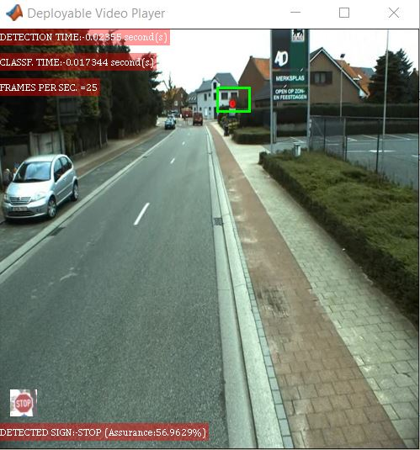
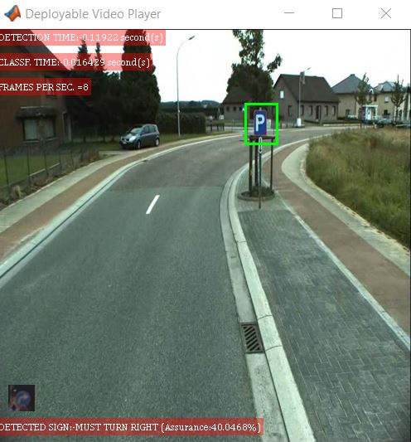
Note: Parking sign not part the classes the system’s Neural Network was trained for

Slide 20
THANK YOU
DETECTION
Connected Component Analysis
Shape Analysis
Critical Area Analysis
Circle Detection
Result
CLASSIFICATION
BNN vs ANN
ANN
TRAINING THE ANN
CNN
CNN LAYERS OF OPERATION
Result
OPTIMIZATION
Parallel Computing
Heterogeneous
Computing
Legacy Coding
Vectorization
Result
SLIDE SUMMARY

